Slide 1

BANK ANALYTICS
Group 6

Slide 2
Agenda
Introduction
Goals & Purpose
Data description
Data cleaning
KPI
Visual Insights
Dashboards
Conclusion & Recommendations

Slide 3

Bank Loan Dashboard

Slide 4
Introduction
The Bank Loan Dashboard is created to get a clear and quick understanding of all the loan-related activities in a bank. It helps to see how loans are being disbursed, how much has been repaid, and which areas or branches are performing better. By showing all this information in one place, the dashboard makes it easier to track performance, identify risks, and take better decisions. It basically turns raw loan data into useful insights that can help in improving efficiency and managing the loan process more effectively.

Slide 5
Goals & Purpose
The main goal and purpose of the Bank Loan Dashboard is to keep track of how the bank’s loan system is performing and to make better decisions using data.
It helps in monitoring loan disbursements, repayments, and recoveries in an easy and visual way. It is designed to show how different branches, customers, and officers are performing, and where improvements are needed.
Overall, the purpose is to make banking operations more transparent, efficient, and data-driven so that management can plan strategies, reduce risks, and improve overall loan performance.

Slide 6
Data Description
The dataset used for this dashboard contains detailed information about different loan accounts from multiple branches and states.
Each row in the dataset represents one customer’s loan record, including personal details, loan amount, interest rate, payments, and recoveries. It also has information about the branch, field officer, and city where the loan was issued.
The data includes around 50+ columns, covering everything from customer demographics to repayment details.
This dataset helps in understanding how loans are performing, how much money has been collected, and how different branches or regions are doing.

Slide 7
Data Cleaning
Removing Blank :- First, we identified and replaced all missing or blank values with "NA" to maintain consistency and prevent calculation errors.
Changing data type :- We corrected data types - for example, the disbursement date column was initially in text format, so we converted it into a proper date format to perform time-based analysis like monthly or yearly trends.
We also standardized text entries in categorical columns such as loan status and branch name to remove duplicates caused by spelling variations or extra spaces.
Outliers and irrelevant records were reviewed and handled carefully to keep the data realistic and reliable.
Finally, We verified that all fields were properly formatted and cleaned, making the dataset ready for visualization and further analysis.

Slide 8
KPI
The Total Loan Applications : 65,535 show the overall demand for loans.
The Total Funded Amount : ₹732.7M represents the total value of loans disbursed to customers.
The Total Amount Received : ₹814.9M indicates the repayment collected from borrowers.
The Average Interest Rate : 12% helps understand the bank’s lending terms.
The Total Recovered Amount : ₹6.5M shows how much has been recovered from previously defaulted loans.

Slide 9
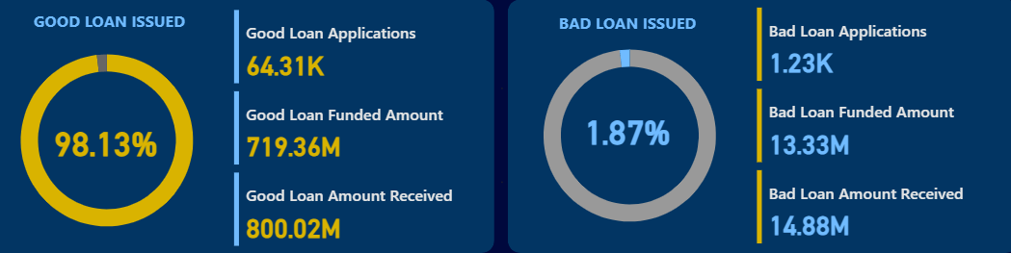
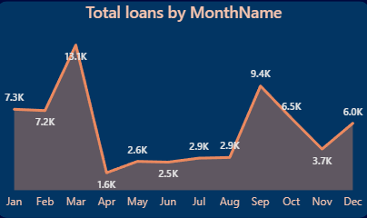
Visual Insights
About 98.13% of the total applications were good loans, meaning most loans were successfully funded and repaid. This shows strong credit quality and effective loan screening.
The chart shows monthly loan trends where the highest applications occurred in March (13.1K) and the lowest in April (1.6K). Loan demand peaks again in September (9.4K), highlighting seasonal variations and helping the bank identify high-demand months for better planning.
Bad loans1.87% of loans turned out to be bad, representing defaults or non-performing loans. This small percentage indicates efficient risk management and good borrower selection.

Slide 10
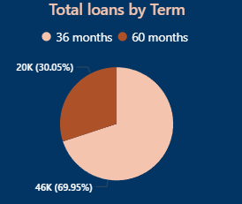
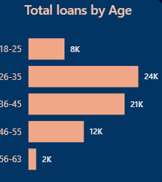
KPI
This chart shows that 36-month loans are the most common, making up 69.95% (46K) of total loans, while 60-month loans account for 30.05% (20K). This indicates that most borrowers prefer shorter repayment terms for quicker closure and lower risk.
The highest number of loans are taken by people aged 26–35 (24K), followed by 36–45 (21K). Younger borrowers (18–25, 8K) and older groups (46–55, 12K; 56–63, 2K) show fewer loans. This suggests that middle-aged adults are the most active in taking loans.

Slide 11
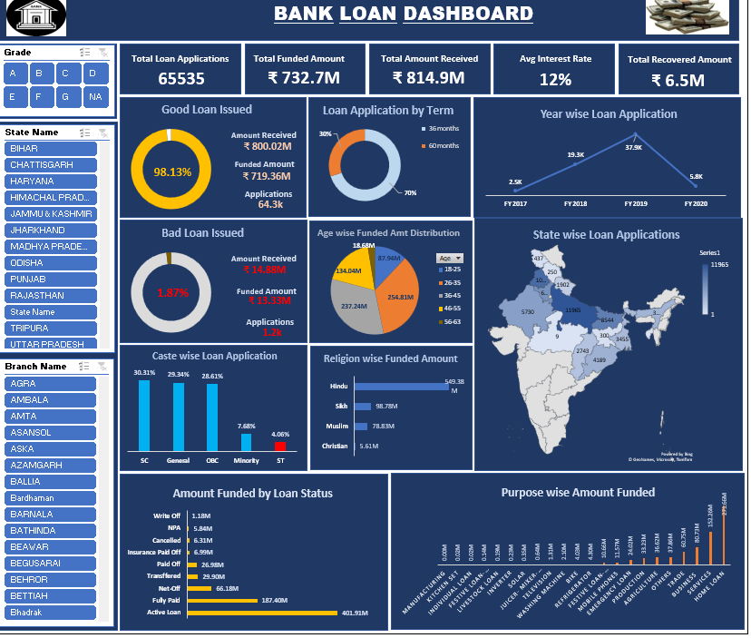
Excel Dashboard

Slide 12
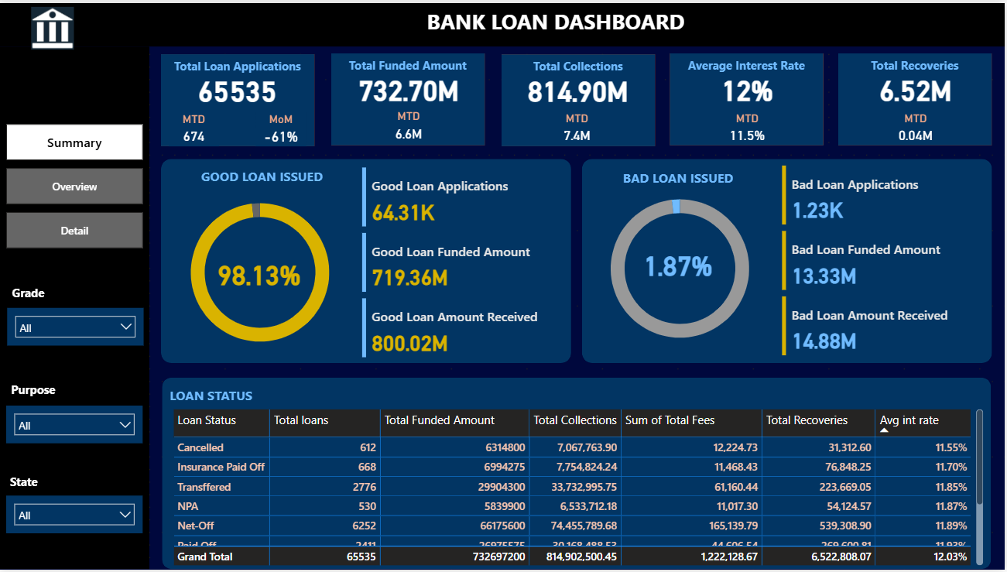
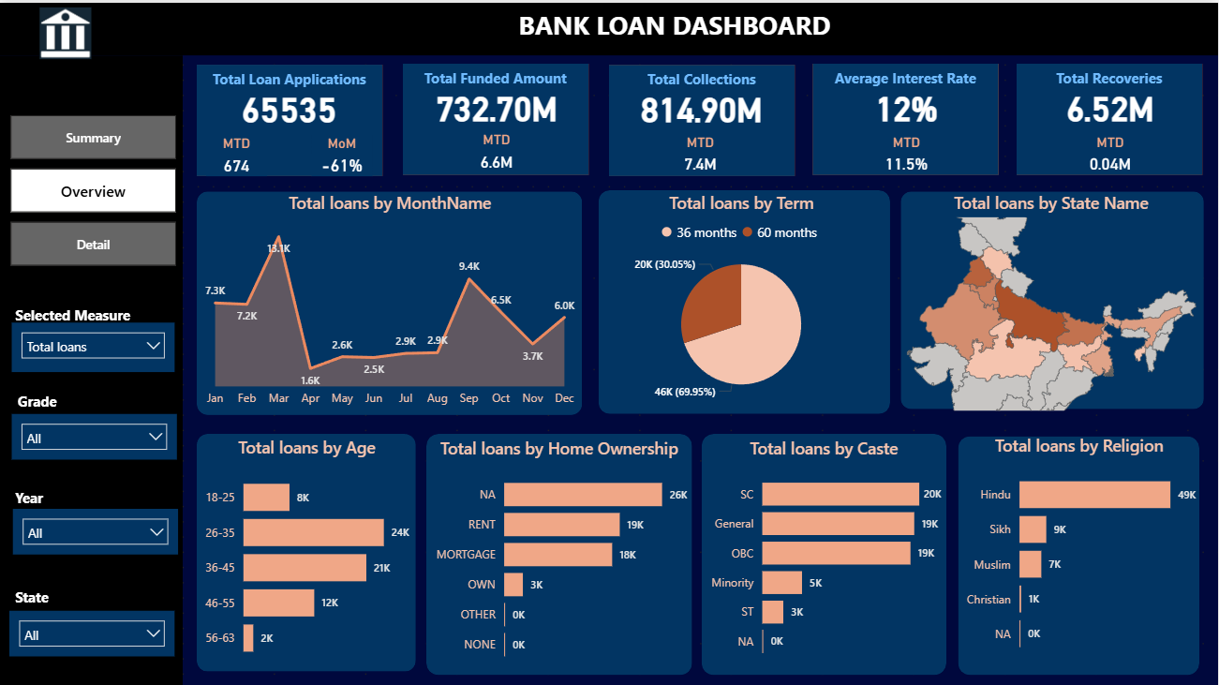
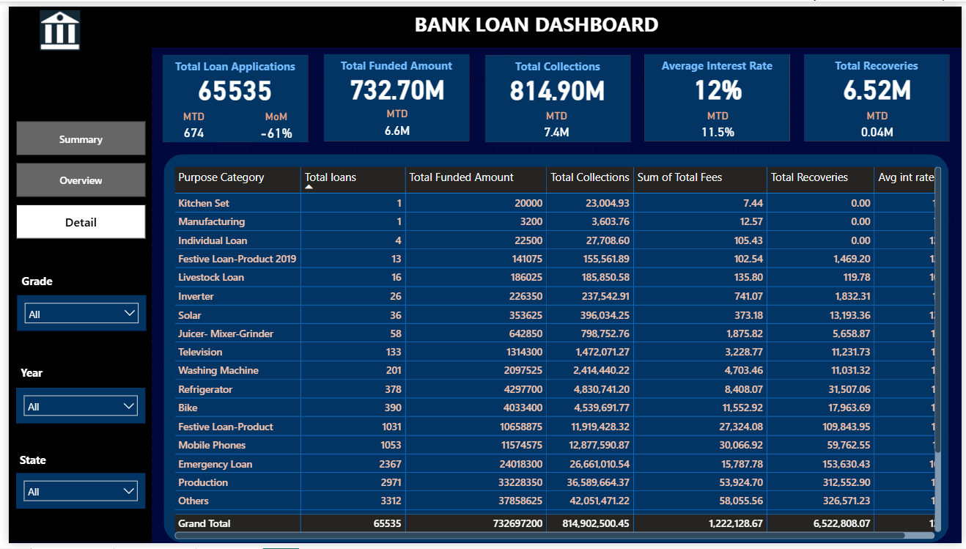
Power BI Dashboard

Slide 13
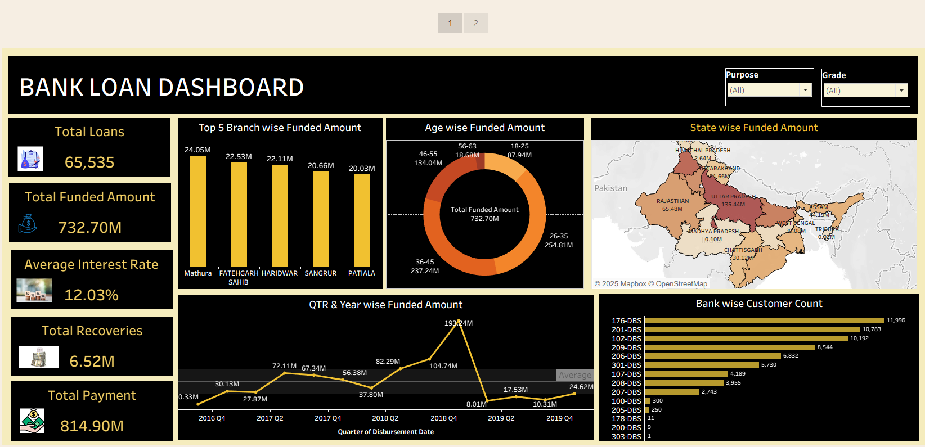
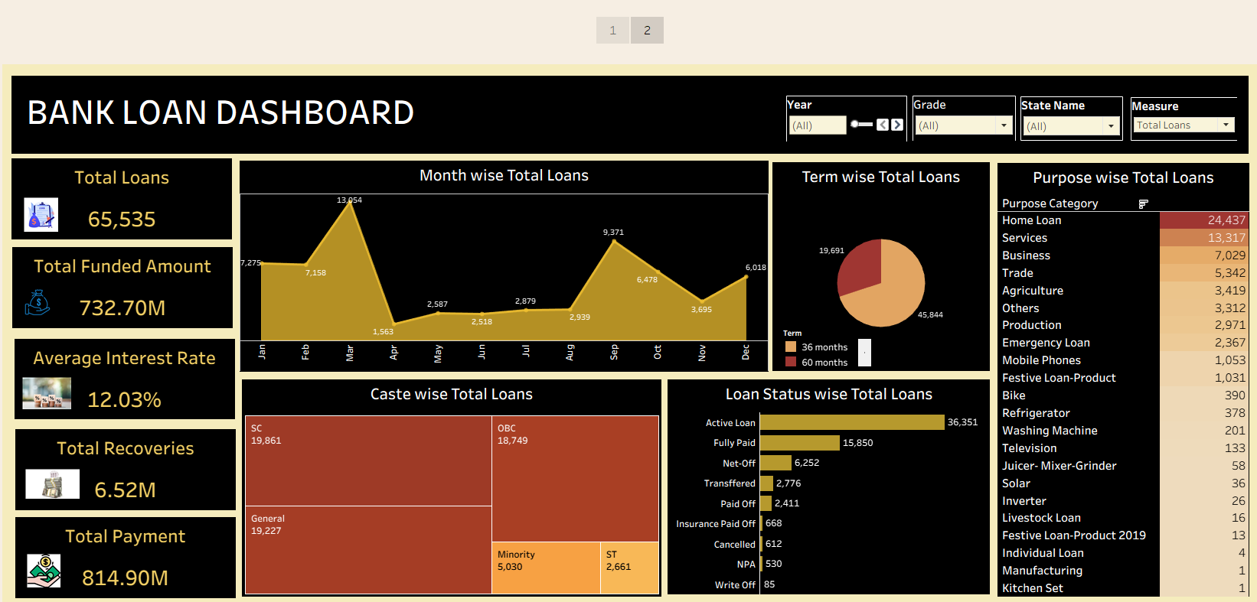
Tableau Dashboard

Slide 14
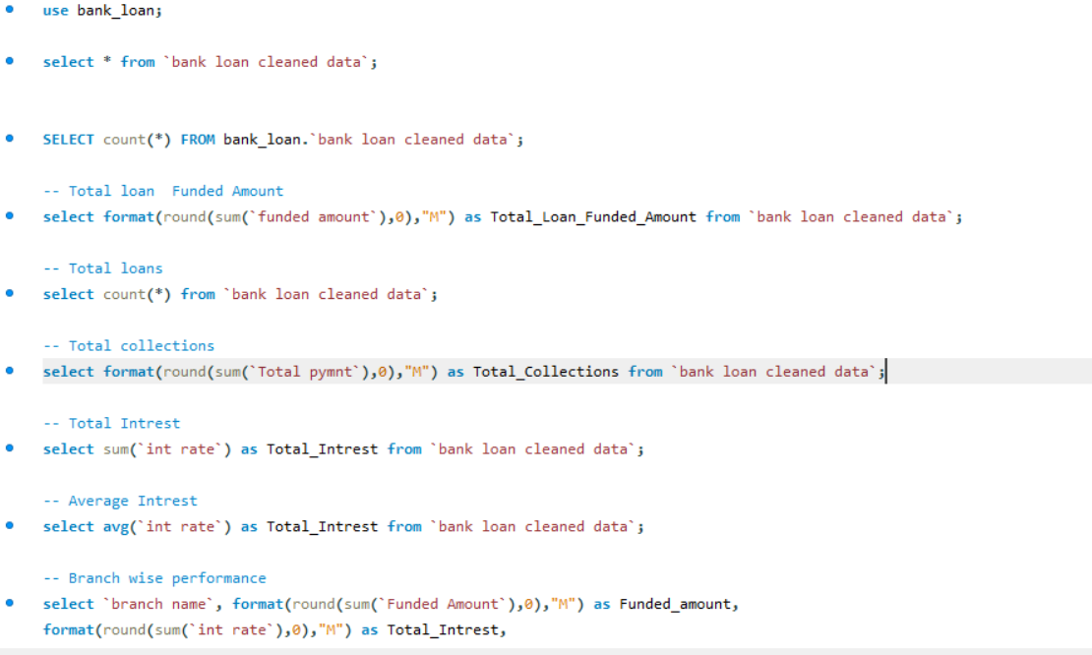
SQL
First, we converted my Excel file into a CSV format and then imported that CSV file into SQL for better data handling.
After importing the data, we used SQL queries to fetch and analyze all loan-related information. we calculated total loan amounts, number of active and closed loans, overdue payments, and repayment details. I also used queries to find KPIs like default rate, loan disbursement count, and average loan amount.

Slide 15
Conclusion & Recommendations
The dashboard provides a clear overview of loan performance and customer insights. It helps in understanding loan disbursements, repayments, overdue amounts, and customer segments. By tracking key indicators like total loan amount, default rate, and repayment trends, it becomes easier to analyze financial health and make data-driven decisions.
Recommendations:
Keep data updated regularly for accurate results.
Focus more on customers with overdue payments.
Add filters to check performance by branch or loan type.
Use insights to plan and reduce future loan risks.

Slide 16

Debit & Credit Dashboard

Slide 17
Introduction
The Bank Debit and Credit Dashboard is made to get a clear and quick understanding of all the money coming in and going out of the bank. It helps to track both debit (money withdrawn or paid) and credit (money received) transactions in one place. By showing this information visually, it becomes easier to analyze transaction trends, customer activity, and overall cash flow.

Slide 18
Goals & Purpose
The main goal and purpose of this data is to monitor the bank’s financial movements efficiently and identify important patterns in debit and credit transactions.
It helps in comparing total debit and credit amounts, understanding which branches or customers have the highest transactions, and spotting any unusual or unbalanced activity.
This data also supports better decision-making by giving a clear view of the bank’s performance and helping management maintain financial stability and transparency.

Slide 19
Data Description & Cleaning
The dataset contains detailed records of bank debit and credit transactions, including customer name, account number, transaction date, transaction type (credit/debit), amount, balance, branch, and transaction method. It helps analyze money inflow and outflow, customer activity, and branch performance.
During data cleaning, duplicate records and missing values were checked and removed, incorrect transaction types were corrected, and date and amount formats were standardized to ensure accurate analysis and reporting.

Slide 20
KPI
Total Credit Amount – 127.60M Shows the total amount of money credited (inflows) across all banks and branches.
Total Debit Amount – 127.29M Represents the total amount of money debited (outflows) from customer accounts.
Account Activity Ratio – 0.019% Indicates the level of transaction activity across accounts, reflecting customer engagement and movement of funds.
Net Transaction Amount – 318.12K The difference between total credits and debits, showing whether overall transactions result in a net inflow or outflow.
Credit to Debit Ratio – 1.0025 Compares total credited amount to total debited amount. A ratio near 1 indicates balanced cash flow between inflows and outflows.

Slide 21
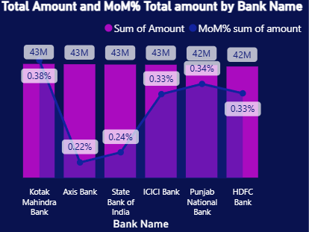
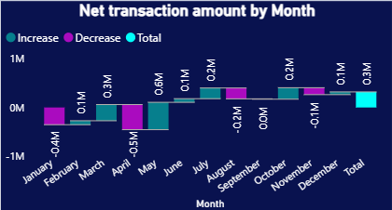
Visual Insights
Compares total transaction amounts by bank (e.g., Kotak Mahindra, Axis Bank, SBI, ICICI, PNB, HDFC).
The line represents Month-over-Month % change, showing growth or decline in transaction activity.
Displays monthly increases and decreases in transaction volume.
Shows fluctuations throughout the year, highlighting months with higher activity (like May, July, and October).

Slide 22
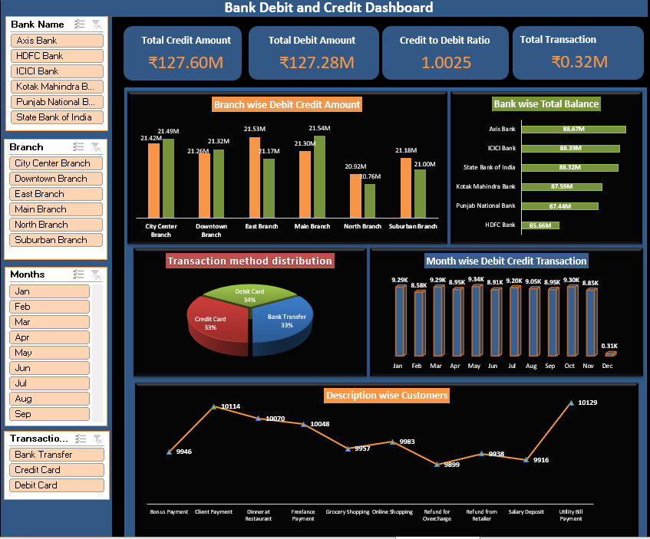
Excel Dashboard

Slide 23
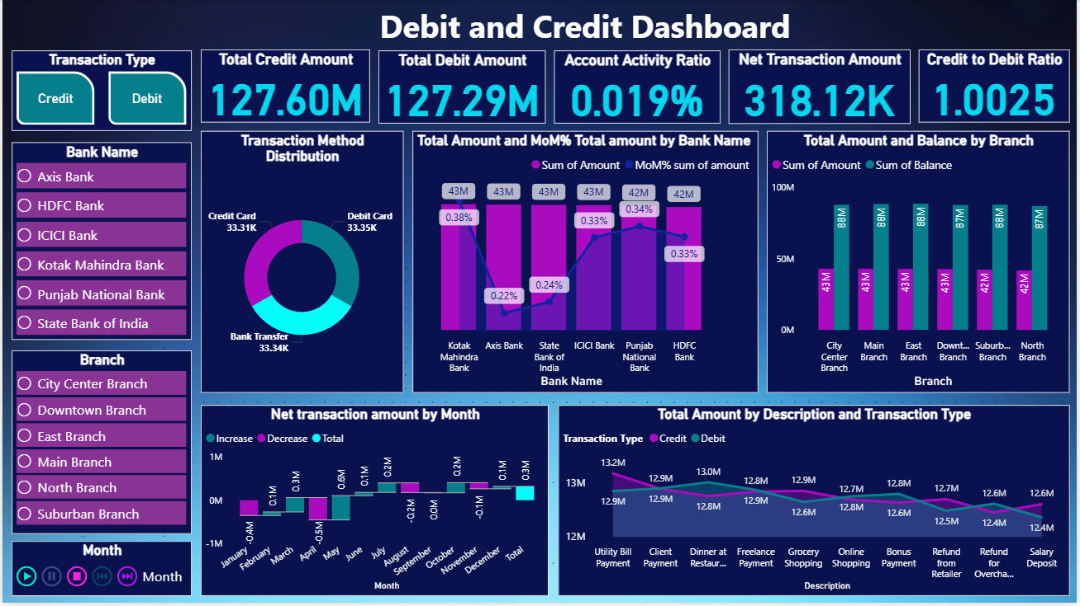
Power BI Dashboard

Slide 24
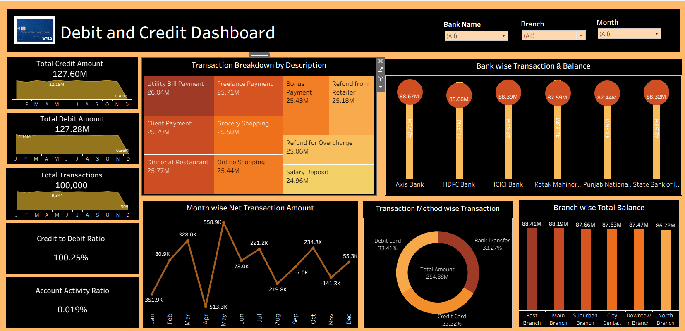
Tableau Dashboard

Slide 25
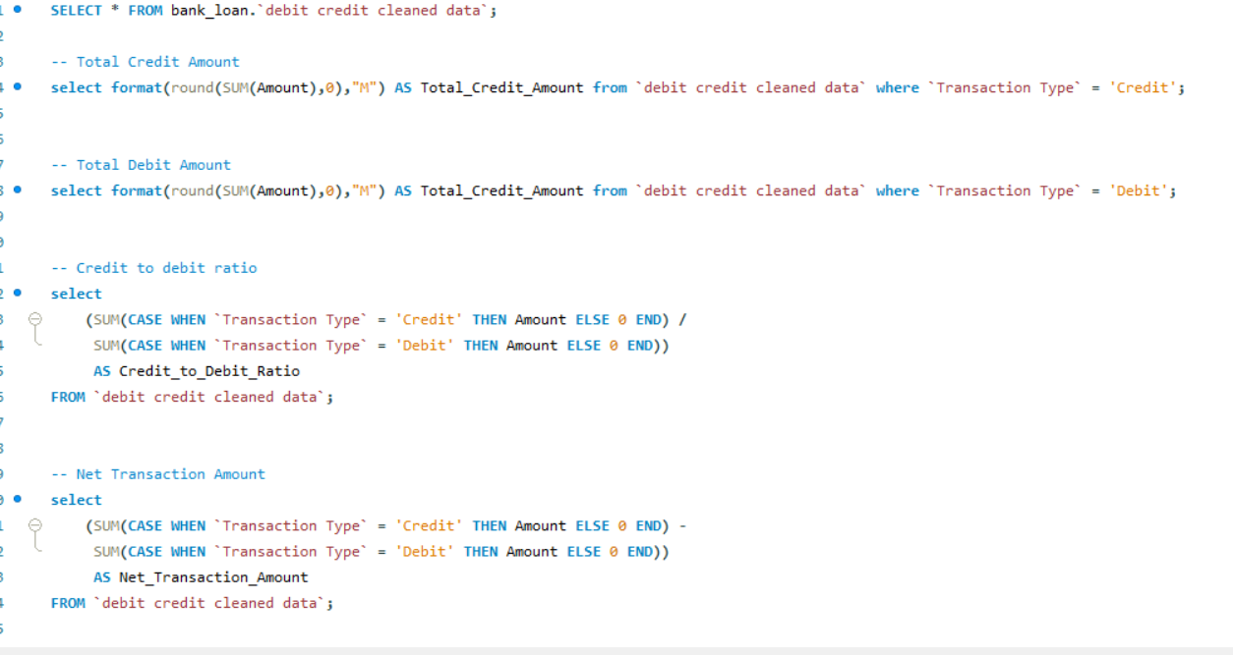
SQL
First, we converted my Excel file into a CSV format and then imported that CSV file into SQL for better data handling.
We used queries to separate debit and credit transactions. Using SQL, we calculated total debit, total credit, balance, and the credit-to-debit ratio. We also checked transaction trends on a daily and monthly basis. These queries helped me to summarize the data and create a clear financial dashboard.

Slide 26
Conclusion & Recommendations
The debit–credit dashboard gives a detailed summary of all financial transactions. It helps in monitoring daily transactions, comparing debit and credit flow, and identifying spending or income trends. It supports better financial tracking and helps in maintaining balance between inflows and outflows.
Recommendations:
Keep track of high-value transactions for better financial control.
Maintain equal focus on both debit and credit trends to ensure balance.
Add time-based comparisons (monthly/quarterly) for better insights.
Use alerts or KPIs to quickly detect unusual or irregular transactions.

Slide 27
Thank You !

